Slide 1
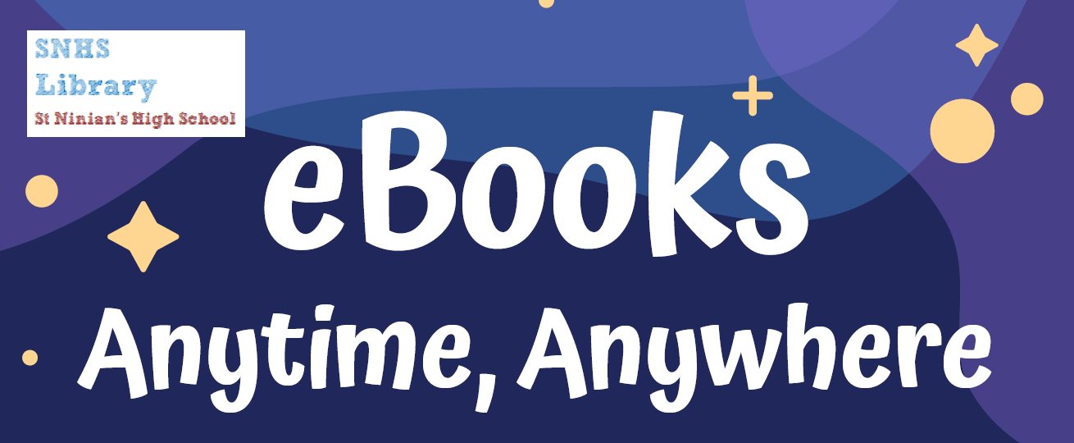
How to download & read eBooks from the library

Slide 2
On a computer
Go to https://st-ninians.eplatform.co, click on Sign In and enter your log-in details.
Change your password by clicking on the arrow next to your name (top right).
Click on Browse to see eBooks you can choose from. Click a cover to select an eBook.
Click on Look Inside for a sample, or Borrow to read the eBook.
When you click Read, the eBook will open.

Slide 3
On a mobile phone/tablet
Download the ePlatform app from your app store.
Open the app and type St Ninian’s Library in the Find Your Library box.
Type in your log-in details. The first time you do this, change your password.
This opens our eBooks homepage. Tap a cover to select an eBook.
Click on Look Inside for a sample, or Borrow to read the eBook.

Slide 4
Good to know
You can borrow up to 2 eBooks at a time.
You have 2 weeks to read an eBook once you’ve borrowed it.
Set font size & style, page colour & spacing by choosing this option in the eBook:
If you’re stuck, email Ms McLean: pmclean@st-ninians.e-dunbarton.sch.uk
You can find Frequently Asked Questions at https://st-ninians.eplatform.co/help/faq

