Slide 1
S5/6 Options Information Evening Monday 16th January 2023

Slide 2
Options Information Evening
Mr Rance Head of S5
Mr Sheerin Head of S6
Mr David Faulds Kelvin College
Notes:
Introduce format and speakers

Slide 3
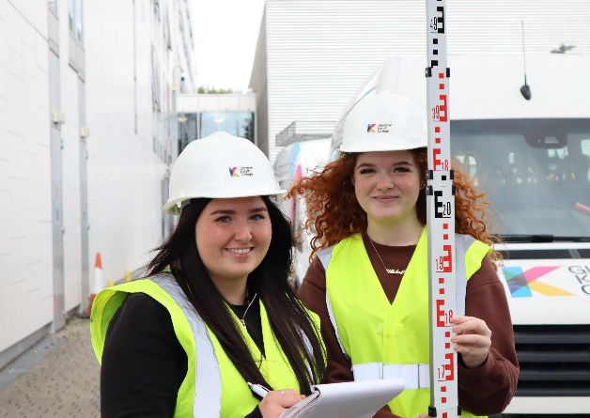
Take the first steps in a career with a Foundation Apprenticeship at Glasgow Kelvin College

Slide 4
What is a Foundation Apprenticeship?
A Level 6 (Higher) qualification you will study towards while still at school
Can be studied over one or two years, so available to both S5 and S6 students when you come back to school in August 2023
Will be one of your subject choices and make up your weekly timetable in school
A great way of combining your time at school with college, and a work placement in your chosen framework

Slide 5
Why choose a Foundation Apprenticeship?
A great opportunity to start a potential career at an early stage
You will develop transferrable skills
More independence
It will make you stand out from the crowd
Can help you into full-time work, modern/graduate apprenticeships, college, or university
Your work is assessed on an ongoing basis- this means there are no end-of-year exams!
91% of completers would recommend Foundation Apprenticeships to others

Slide 6
What Foundation Apprenticeships are available at Kelvin College?
Mechanical Engineering
Engineering Systems
Civil Engineering
Social Services Children and Young People (S6 Only)
Creative and Digital Media (S6 only)
*Courses are subject to change*
*Both City & Clyde Colleges offer their own FA frameworks

Slide 7
How is a Foundation Apprenticeship delivered?
Your ongoing work in college and on placement means you gain your FA
5th year student?
You attend college 2 half days per week on Tuesday and Thursday afternoons
6th year?
You attend 2 full days per week on Tuesdays and Thursdays.
In the 2nd year of your FA, you will split your days between college and work placement. If choosing a 1-year Engineering course, you can be out of school 3 days per week

Slide 8
Some of the employers we partner with…

Slide 9
Where can a Foundation Apprenticeship take you after school?
Fast Track Modern Apprenticeship
College HNC/HND
Employment
University (Degree or Graduate Apprenticeship)
FOUNDATION APPRENTICESHIP

Slide 10
What do I need to gain entry?
Students are expected to have an interest in developing greater awareness of the industry with a potential desire to pursue as a career
Students must be capable of working at Level 6 (Higher) over S5 and S6
Some Frameworks require English and Maths in order to join the course
Frameworks last 1 or 2 years. No Foundation Apprenticeship qualification will be awarded if participants leave early

Slide 11
How do I apply?
Applications are made through www.fapglasgow.scot
Click on the Glasgow Kelvin Link to take you to our frameworks
Applications require a reference from a member of staff at the school – typically a Pastoral Care teacher, Depute Head or Careers Advisor
Applications are open at the end of January 2023. Places are offered on a first come first served basis.
A waiting list will commence once all places are filled.

Slide 12
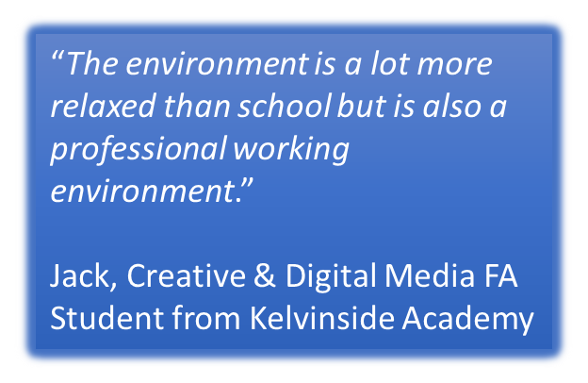
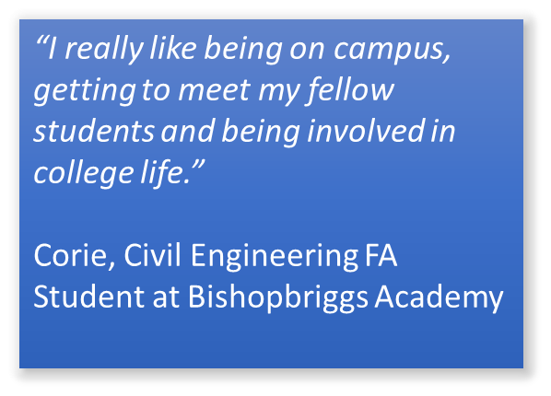
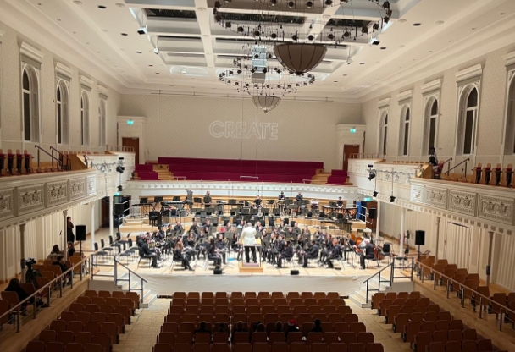
What this years students are saying…
“I’m really looking forward to the work placement element which kicks in this year where we will learn proper workplace skills.”
Chloe, Civil Engineering FA Student from St Rochs Secondary

Slide 13
As well as FAs, we have a number of other options available to you…
Automotive (level 4 FA)
Construction (level 4 FA)
Childcare
Psychology
Mental Health & Criminology
Current Trends in Hairdressing
Adventure Sports & Fitness
Uniformed Emergency Services
Building Services Engineering
Musical Theatre & Higher Dance

Slide 14
Thank you.
For more information, please contact David Faulds at dfaulds@glasgowkelvin.ac.uk, or call on 07747461587

Slide 15
Senior Phase – St. Ninian’s
S4
7 subjects
National 3
National 4
National 5
S6
Up to 5 subjects
NPA
National 5
Higher
Advanced Higher
Wider Achievements
S5
Up to 5 subjects
NPA
National 4
National 5
Higher
Advanced Higher
Wider Achievements

Slide 16
Progression Route
Learner Journey at High School
P7
S1
S2
S3
S4
S5
S6
Broad General Education
(BGE)
Third and Fourth Level
Senior Phase
(National Qualifications)
N4/N5/Higher/Adv Higher
BGE – Nursery to the end of S3
Continuous Assessment through a RANGE of evidence
Focus on:
Developing Literacy, Numeracy and Health & Wellbeing
Skills Development for learning, life and work
Progression in their learning – pathways
Attainment AND Achievement

Slide 17
In St Ninian’s
Senior Phase
(National Qualifications)
N4/N5/Higher/Adv Higher
S1
S2
S3
S4
S5
S6
Pupils follow a BGE until end of S3
Pupils study every subject
Personalisation and Choice
choice
choice
choice
National 4
National 5
Higher
National 5
Higher
Adv Higher
Pupils prepare for National Qualifications

Slide 18
S4 ➔ S5 Options 2023
1. There are no compulsory subjects
2. You must choose subjects that you have been doing in S4.
3. Your choice should be based on what you consider to be your best subjects and therefore the subjects in which you will achieve your best grades.
4. You should try to indicate whether you are expecting to study the subject at Higher (H), National 5 (Nat 5) or National 4 (Nat 4).
5. This exercise does not guarantee that you will be able to be given your complete choice of subjects. You need to make a 2nd choice for each column.
6. Following discussion with your Guidance teacher and your parents, you should return your completed option form by 9th March (earlier is preferable)

Slide 19
S5 OPTIONS FORM 2023
 | COLUMN A | COLUMN B | COLUMN C | COLUMN D | COLUMN E
 | Geography (H) History (H) Modern Studies (H) Maths (H) Maths (N5) Applications of Maths (N5) Maths (Level 5) Social Subject (History OR Modern Studies) (N5) | Biology (H) Chemistry (H) Chemistry (N5) Physics (H) English (H) English (N5) Health Sector (NPA) Lab Skills – Forensics (NPA) Languages for life, work and Travel (N4 /N5) | Art & Design (H) Design & Manufacture (H) Practical Woodworking (N5) Dance (N5) French (H) Spanish (H) Maths (H) Maths (N5) Maths (Level 5) Music (H) PE (H) Hospitality: Practical Cake Craft (N5) | Business Management (H) Computing Science (H) Graphic Communication (H) Graphic Communication (N5) History (H) Modern Studies (H) English (H) English (N5) Drama (H) Work Placement Foundation Apprenticeships College Option (Tuesday & Thursday afternoon) Cyber Security (NPA) Games Design (NPA) | Creative Industries (NPA) Early Years & Childcare (NPA) Administration & IT (H) Art & Design (H) Biology (H) Biology (N5) Business Management (H) Chemistry(H) Physics (H) Physics (N5) Music (H) Spanish (H) PE (H)
1st Choice
2nd Choice

Slide 20
S5 ➔ S6 Options 2023
1. Your choice should be based on what you consider to be your best subjects and therefore the subjects in which you will achieve your best grades. Alternatively you will choose subjects that will best assist you once you have left school for example – UCAS Applications
2. You should try to indicate whether you are expecting to study the subject at Advanced Higher (AH), National 5 (Nat 5)
3. This exercise does not guarantee that you will be able to be given your complete choice of subjects.
Following discussion with your Guidance teacher and your parents, you should return your completed option form by 9th March (earlier is preferable).
5. Private Study will only be granted following publication of SQA Exam results. This is only applicable to those studying Advanced Highers following a discussion with the Guidance Teacher and Year Head. This is to help facilitate independent study as part of the research required for Advanced Higher courses.

Slide 21
S6 OPTIONS FORM 2023
 | COLUMN A | COLUMN B | COLUMN C | COLUMN D | COLUMN E
 | Geography (H) History (H) Modern Studies (H) Maths (H) Maths (N5) Applications of Maths (N5) Maths (Level 5) Social Subject (History OR Modern Studies) (N5) History (AH) Modern Studies (AH) Geography (AH) Mathematics (AH) | Biology (H) Chemistry (H) Chemistry (N5) Physics (H) English (H) English (N5) Health Sector (NPA) Lab Skills – Forensics (NPA) Languages for life, work and Travel (N4 /N5) Politics (H) Biology (AH) English (AH) Physics (AH) | Art & Design (H) Design & Manufacture (H) Practical Woodworking (N5) Dance (N5) French (H) Mandarin (H) Spanish (H) Maths (H) Maths (N5) Maths (Level 5) Music (H) PE (H) Hospitality: Practical Cake Craft (N5) Photography (H) Environmental Science (H) French (AH) Mandarin (AH) Music (AH) | Business Management (H) Computing Science (H) Graphic Communication (H) Graphic Communication (N5) History (H) Modern Studies (H) English (H) English (N5) Drama (H) Work Placement Foundation Apprenticeships College Option (Tuesday & Thursday afternoon) Cyber Security (NPA) Games Design (NPA) Drama (AH) Leadership – Skills Academy | Creative Industries (NPA) Early Years & Childcare (NPA) Administration & IT (H) Art & Design (H) Biology (H) Biology (N5) Business Management (H) Chemistry(H) Physics (H) Physics (N5) Music (H) Spanish (H) PE (H) RMPS (H) Art & Design (AH) Chemistry (AH) Spanish (AH) Refereeing (Level 7) Sport Dev (NPA)
1st Choice
2nd Choice

Slide 22
Developing The Young Workforce
1
2
Develop skills for learning, life and WORK
3
Provide opportunities for all young people
Bridge the gap between school and the workplace

Slide 23
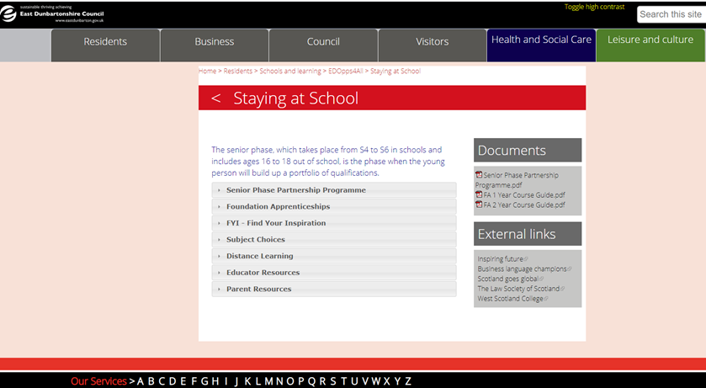
Senior Phase Prospectus 2023/24

Slide 24
The Senior Phase Programme
Wide range of courses offering young people a variety of options with the majority accredited by the SQA.
Purpose is to help young people develop skills for learning, life and work and support the transition from school.
Open to pupils in S4-6 from August 2023.
Delivery for most courses is over 2 afternoons for 1 academic year or 1/2 academic years for Foundation Apprenticeships .
Courses are delivered at partnership colleges.
Courses range from SCQF Level 3 – 8.
More information on courses, level and location can be found on the school website or online at: www.eastdunbarton.gov.uk/edopps4all

Slide 25
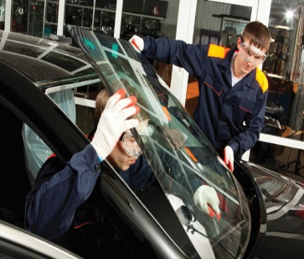
Senior Phase Courses 2023/2024
50 courses offered over 4 sectors:
Care, Health & Sports Industries
Creative & Digital Industries
Business & Service Industries
Science, Engineering, Design &
Manufacture Industries

Slide 26
Senior Phase Courses - 2020/21
BUSINESS & SERVICE INDUSTRIES
Financial Services
Fashion Brand Retailing
Up in the air & on the ground: Hospitality, Events & Tourism
Intro to Food Services
Professional Cookery
Bakery & Cake Decoration
Scots & Criminal Law
Supply Chain Operations
SCIENCE, ENGINEERING, DESIGN & MANUFACTURE
Automotive Engineering
Building Services Engineering
Mechanical Engineering
Computer Aided Design
Construction
Construction Crafts
Construction Skills for Young Women
Construction Management
Maritime Skills

Slide 27
CREATIVE & DIGITAL INDUSTRIES
Computer Games Development
Creative Digital Media
Hair & Make-Up Artistry
Hairdressing
Barbering Skills
Beauty Skills
Personal Presentation
Professional Theatre
Television Production
Sound Production: Recording
CARE, HEALTH & SPORTS
INDUSTRIES
Applied Anatomy
Introduction to Care and Humanities
Early Education & Childcare
Health, Child & Social Care
Introduction to Nursing
Introduction to Teaching
Health & Social Care: Skills for Practice
Higher Psychology
Coach4Success
Coach of Tomorrow
Dance
Sport Fitness & Outdoor Education
Transitions

Slide 28
Our College Partners
Springburn Campus
Easterhouse Campus
City Campus
Riverside Campus
Anniesland Campus
Cardonald Campus
Langside Campus
Kirkintilloch Campus
University of Strathclyde
Glasgow Caledonian University

Slide 29
Further Information and How to Apply
The Prospectus will be available online at the end of January: www.eastdunbarton.gov.uk/edopps4all
Pupils should discuss senior phase courses with their Guidance Teacher during the option choice process.
Online Application Forms open for both Senior Phase Partnership Programme courses and Foundation Apprenticeships – Following publication – deadline is early April to apply for places.

Slide 30
Work Experience
Column D
Tuesday & Thursday PM
Pupils to organise

Slide 31
Options Process – Key Dates
January Options Assemblies for pupils
16th January Information Evening for parents
Feb/March Individual Interviews with Guidance Team
7th March S5/6 Parents’ Reporting Evening
9th March Final date for return of completed Option Forms

Slide 32
What Help/Advice is Given?
Senior Management Team
Guidance Staff
Subject Teachers
Careers Officer
Parents/Relatives
Insert in Supporting Learners classes
Access to Careers Hub (SDS)

Slide 33
Michelle Dickson Careers Adviser
Facebook & Twitter
We’re here to help
Careers Drop-In on Monday, Tuesday, Thursday and Friday in the room behind the Medical Room.
0141 777 5860

Slide 34
My World of Work
My career options
Explore your options, from school subjects right through your career. Find a job that suits you.
Learn and train
Search for courses and volunteering opportunities. Get advice on how to apply for courses, qualifications and funding.
Getting a job
Search for job vacancies. Use the tips and tools to write CVs or application forms, and get ready for interviews.

Slide 35
Expectations
Increased expectations.
Added responsibility.
Considerable step up in work
rate.
Attendance

