Slide 1
Study Skills
Notes:
Introductions and schedule for the visit
Developments over the last year since previous visit
Continued commitment from staff under pressure from national qualifications, literacy & HWB.
Numeracy team continue to build a shared understanding and expectations of numeracy learning across the curriculum through whole school events, PT meetings, PT/SMT focus group meetings and of course through representation in all DMs.
Partners including businesses and parents have been integral to the continued development of numeracy across the curriculum.

Slide 2
What are Study Skills?
Study skills can be described as ‘learning how to become an effective learner and how to manage your own learning’.
Good study habits laid down early will provide a strong foundation for the learning that comes later.

Slide 3
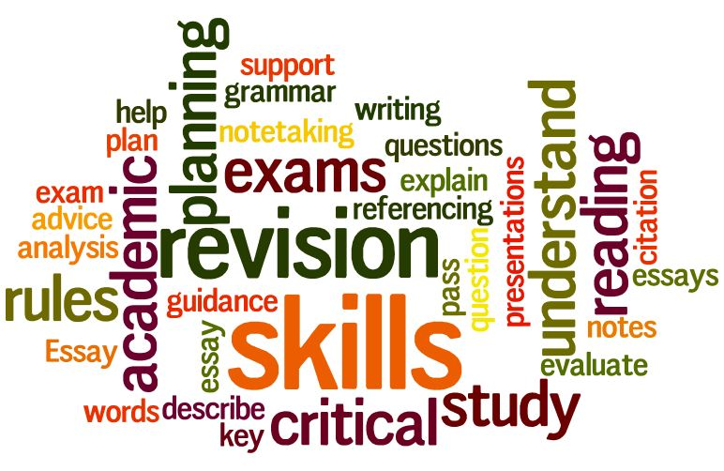
Strategies
There are four main stages for effective studying and the successful processing of information
Get;
Understand;
Remember;
Do

Slide 4
Task
On the next two slides there are a series of interactive activities for you to work through. These should help you to identify study skills relevant to you.
Click on the hyperlinks to access them.

Slide 5
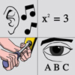
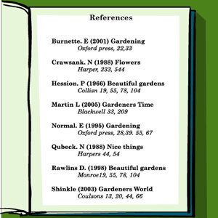
Do…
Essay Writing
Learning in Context
Learning Styles
Remember…
Memory Skills
Referencing

Slide 6
Understand…
Summarising
Get…
Learn from Lectures
(useful for taking notes)

